Slide 1
Channel Estimation for Orthogonal Time Frequency Space (OTFS) Massive MIMO
¹Wenqian Shen, ²Linglong Dai, ³Shuangfeng Han, ³Chih-Lin I,
and ⁴Robert W. Heath, Jr.
¹School of Information and Electronics, Beijing Institute of Technology
²Department of Electronic Engineering, Tsinghua University
³Green Communication Research Center, China Mobile Research Institute
⁴Department of Electrical and Computer Engineering, The University of Texas
at Austin
Notes:
Good morning everyone! I am very glad to be here to share my work about channel estimation for Orthogonal Time Frequency Space, OTFS for short, massive MIMO systems. I am the first author Wenqian Shen from Beijing Institute of Technology, China. This work is coauthored with prof. Linglong Dai, Dr. Shuangfeng Han, Dr. Chih-Lin I, and prof. Robert Heath.
In this work, we investigated the problem of OTFS massive MIMO channel estimation, which is a challenging task due to the required high pilot overhead. To solve this problem, we exploited the 3D structured sparsity of OTFS massive MIMO channels and proposed a 3D-SOMP algorithm for channel estimation.

Slide 2
Outlines
System Model
Delay-Doppler-Angle 3D Channel
3D-SOMP Based Channel Estimation
Simulation Results
Notes:
My presentation includes four parts: the system model, the delay-Doppler-angle 3D channel in OTFS massive MIMO systems, our proposed 3D-SOMP based channel estimation method, and our simulation results.

Slide 3
OTFS SISO Modulation
OTFS modulation at the transmitter is composed of an OTFS pre-processing block and a traditional frequency-time modulator such as OFDM.
The OTFS pre-processing block maps the 2D data block in the delay-Doppler domain to the 2D block in the frequency-time domain by using the inverse symplectic finite Fourier transform (ISFFT).
Notes:
Let’s start with the system model of OTFS SISO. We present the discrete-time formulation of OTFS modulation and demodulation. Specifically, OTFS modulation at the transmitter is composed of an OTFS pre-processing block and a traditional frequency-time modulator such as OFDM.
The OTFS pre-processing block first maps the 2D data block X^DD in the delay-Doppler domain to the 2D block X^FT in the frequency-time domain by using the inverse symplectic finite Fourier transform (ISFFT).
Then, each column of X^FT is regarded as an OFDM symbol, which will be transformed to the time-domain signal for transmission by using the M-point IDFT.

Slide 4
OTFS SISO Demodulation
OTFS demodulation at the receiver is composed of the traditional OFDM demodulator and an OTFS post-processing block.
The OTFS post-processing block maps the received signals in the frequency-time domain to the 2D block in the delay-Doppler domain by using the SFFT.
Notes:
Similarly, OTFS demodulation at the receiver is composed of the traditional OFDM demodulator and an OTFS post-processing block.
The received signals r is first transformed into the frequency domain through the M-point DFT, which will be reorganized as the matrix Y^FT of size M times N.
Then, the OTFS post-processing block Y^FT in the frequency-time domain to the 2D block Y^DD in the delay-Doppler domain by using the SFFT.

Slide 5
OTFS Input-Output Relation
Lemma 1: The received data is given by the phase compensated 2D periodic convolution of the transmit data with the delay-Doppler channel impulse response (CIR) , which is shown as follows:
where , , and are the -th element of YD , , and ( , ).
Time-variant CIR
Notes:
In this page, we present the input-output relation of OTFS in Lemma 1. we show that the received data Y^DD is given by the phase compensated 2D periodic convolution of the transmit data X^DD and the delay-Doppler channel impulse response (CIR) H^DD. The delay-Doppler CIR is obtained by the DFT of the time-variant CIR.

Slide 6
OTFS Massive MIMO
OTFS working in massive MIMO systems can further increase the spectrum efficiency by using multi-user MIMO.
The main challenge for OTFS massive MIMO is the downlink channel estimation due to the required high pilot overhead.
Notes:
Now we describe an extension of OTFS into massive MIMO systems to further increase the spectrum efficiency by using multi-user MIMO as shown in the figure. The main challenge for OTFS massive MIMO is the downlink channel estimation due to the required high pilot overhead.

Slide 7
Delay-Doppler-angle 3D Channel
The time-variant CIR associated with the -th antenna can be expressed as
Then, the delay-Doppler-angle 3D channel is given by
Path gain
Doppler frequency
Time delay
Spatial AoD
Notes:
To solve this problem, we present the delay-Doppler-angle 3D channel, which is given by the second equation. Observe that the function Gamma_N(x) dramatically decreased as x increases. Thus, the 3D channel H^DDA is sparse.

Slide 8
3D Sparsity of Delay-Doppler-angle Channel
The 3D channel is sparse along the delay dimension, block-sparse along the Doppler dimension, and burst-sparse along the angle dimension.
Notes:
We further show that the 3D channel is sparse in delay domain, block-sparse in the Doppler domain, and burst-sparse in the angle domain.

Slide 9
Training pilots in the delay-Doppler Domain
To reduce the overall pilot overhead in OTFS massive MIMO systems, we propose the non-orthogonal pilot pattern, i.e., pilots transmitted at different antennas completely overlap.
The training sequences at different antennas are independently generated
Notes:
Now we discuss the channel estimation of the 3D channel. To reduce the overall pilot overhead in OTFS massive MIMO systems, we propose the non-orthogonal pilot pattern. That means the pilots transmitted at different antennas completely overlap, but the training sequences at different antennas are independently generated.

Slide 10
Formulation of OTFS Channel Estimation
Based on the OTFS input-output relation, the received pilots can be expressed as
Rewrite it into the vector-matrix form as
DFT of the transmit pilots
This is a sparse signal recovery problem.
Notes:
Based on the OTFS input-output relation, we formulate the channel estimation problem as a sparse signal recovery problem.

Slide 11
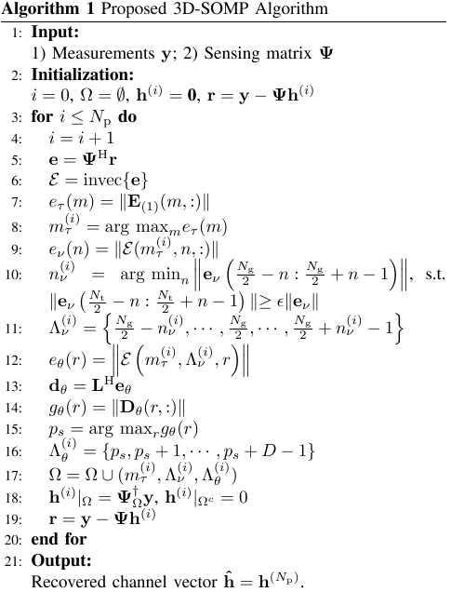
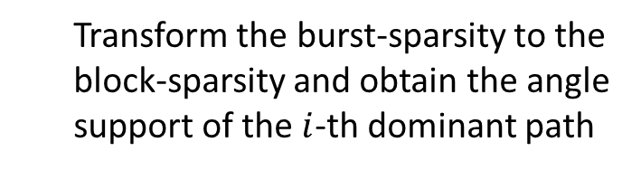
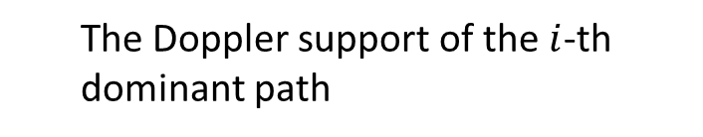
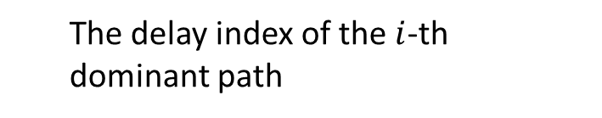
3D-SOMP Algorithm
Reshape the correlations as the same size of the 3D channel matrix
The delay index of the $i$-th dominant path
The Doppler support of the $i$-th dominant path
Transform the burst-sparsity to the block-sparsity and obtain the angle support of the $i$-th dominant path
Notes:
This problem is solved by our proposed 3D-SOMP algorithm. The main idea is to identify the 3D support in an one by one fashion. To do this, we first identify the delay index of the i-th path, based on which, we identify the Doppler support of the path. Finally, we transform the burst sparsity along the angle dimension to the traditional block sparsity.

Slide 12
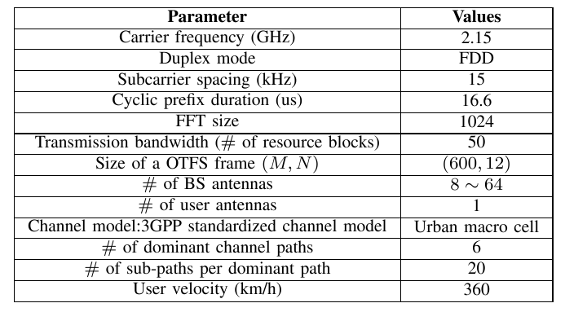
Simulation Results
For comparison, we also simulate the traditional impulse-based channel estimation method and traditional OMP-based channel estimation method.
System parameters for simulations:
Notes:
Finally, we show our simulation results.

Slide 13
Simulation Results
NMSE vs. Pilot overhead
To achieve a constant NMSE, the required pilot overhead of the proposed method is smaller than that of its traditional counterparts.

Slide 14
Simulation Results
NMSE vs. # of BS antennas
The proposed method works well with a large number of BS antennas.

Slide 15
Simulation Results
BER vs. SNR
The proposed method achieves satisfying BER performance, which is very close to the case with perfect CSI in OTFS systems.

Slide 16
Conclusions
Show the 3D sparsity of delay-Doppler-angle channel
Derive the discrete-time formulation of OTFS modulation/demodulation
Propose a 3D-SOMP algorithm for channel estimation in OTFS massive MIMO systems

Slide 17
Contact Information
Thank you for your attention !
  Wenqian Shen
  Beijing Institute of Technology
  wshen@bit.edu.cn
  http://oa.ee.tsinghua.edu.cn/dailinglong/members/wenqianshen

